Slide 1
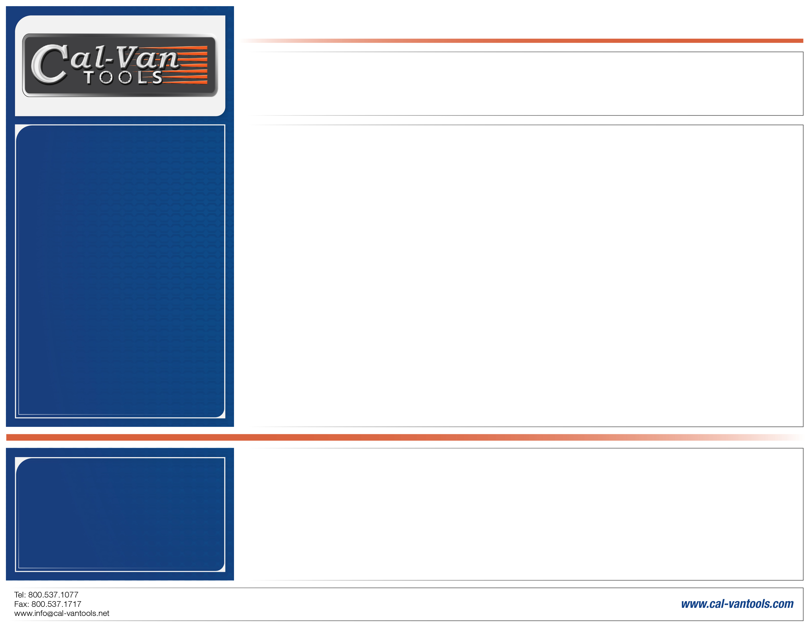
Part No. 23
Telescoping Pick Up Tool with 16 lbs. Capacity
Get the reach and strength you need with a telescoping magnet pick up tool with an ergonomic, textured grip and 16-pound lifting capacity.
Retrieve items up to 16 lbs. from tight or hard-to-reach areas
Magnetic head with shield to keep from sticking to surfaces and debris
Closed the unit is 6-½" and the stainless-steel handle extends to 37"
Features an ergonomic textured grip
Package Type: Sliding Blister and Card
Applications:
Numerous applications to pick up metal objects in hard-to-reach areas.
Dimensions: 2.47" x 11.61" x .94"
Warranty: Limited Lifetime Against Defects
UPC: 047084000236

